Slide 1
EMC Flow Calculator Data Product QA
Comparison against Excel Data

Slide 2
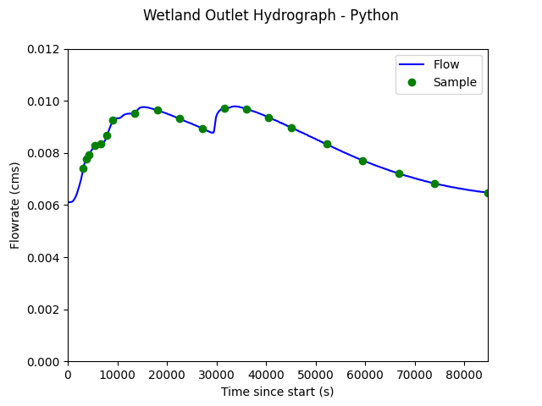
Auckland Wetland Outlet - Hydrographs

Slide 3
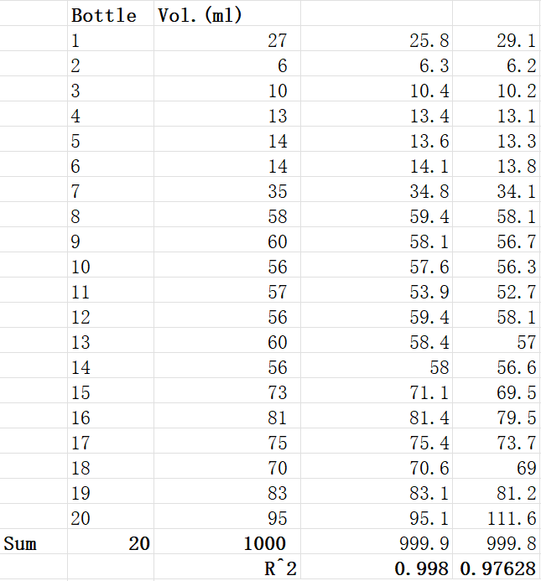
Auckland Wetland Outlet – EMC instructions

